Slide 1


Sujin Subanthran
14/02/2025

Slide 2
Outline
Executive Summary
Introduction
Methodology
Results
Conclusion
Appendix

Slide 3
The data was collected and cleaned by removing rows with multiple cores and payloads, enriching it with information about landing outcomes, launch sites, and core characteristics
Missing values were handled by replacing NaN values in the Payload Mass column with the mean. The analysis focused on Falcon-9 launches, with data from four launch sites: CCAFS LC-40, VAFB SLC-4E, KSC LC-39A, and CCAFS SLC-40
Key findings include the highest success count at CCAFS LC-40 (46.4%) and the highest success ratio at KSC LC-39A (76.9%). The 5000-7000 kg payload range had the highest failure rate, while the 2500-7000 kg range had the highest success rate.
The ‘FT’ booster version achieved the best success rate, and SVM performed the best with 83.3% accuracy
The key methodologies used in this project involve data collection, exploratory data analysis, machine learning, hyperparameter tuning, and model evaluation.
The end goal is to build a predictive model to determine Falcon 9's first-stage landing success, which can be applied to make data-driven business decisions regarding cost savings, bidding, and reducing launch risks.
Executive Summary

Slide 4

Introduction
SpaceX's reusable rocket technology is one of the core innovations that has significantly reduced the cost of space missions
The ability to predict landing success would allow SpaceX to optimize its operations, ensuring that booster landings are more predictable, which could lead to better mission planning, increased reusability, and ultimately cost savings
For example, accurately forecasting whether a booster will land successfully can help SpaceX decide whether to allocate resources for recovery operations or adjust flight plans accordingly. Additionally, bidding for contracts often relies on estimates of mission costs, and being able to predict landing success would enhance SpaceX’s ability to offer competitive pricing and improve their market position.
In essence, predicting landing success is crucial for increasing the reliability of the reusable rocket program, making spaceflight more economically viable and sustainable
The project aims to answer the question of how can we use data to improve the efficiency, reliability, and cost-effectiveness of space missions—focusing on one of the key innovations in modern space exploration: reusable rockets

Slide 5

Section 1

Slide 6

Methodology
Executive Summary
Data collection methodology:
Describe how data was collected
Perform data wrangling
Describe how data was processed
Perform exploratory data analysis (EDA) using visualization and SQL
Perform interactive visual analytics using Folium and Plotly Dash
Perform predictive analysis using classification models
How to build, tune, evaluate classification models

Slide 7

Data Collection
Making a GET request to a SpaceX API to retrieve launch data in JSON format
1
Transforming the JSON data into a pandas DataFrame
2
Extracting relevant features (like payload mass, orbit, and booster version) using the API data
3
Filtering and enriching the data by adding details like landing outcomes, launch sites, and core characteristics
4
https://github.com/ex22760/Data-Science/blob/main/jupyter-labs-spacex-data-collection-api.ipynb

Slide 8
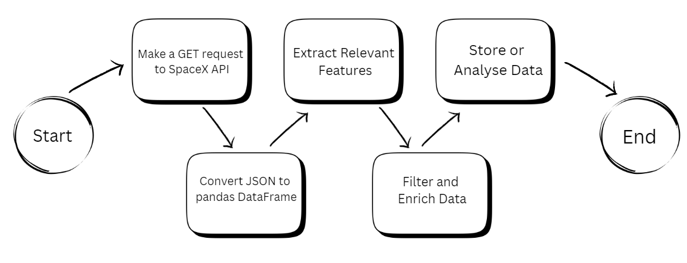
Data Collection – SpaceX API

Slide 9
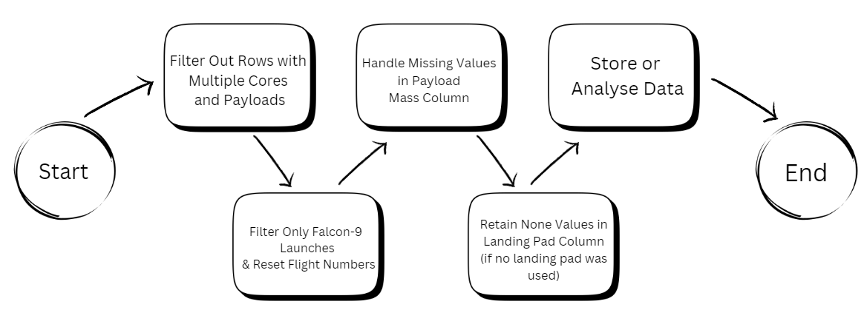
Data Collection - Scraping

Slide 10

Data Wrangling
Cleaning the dataset by filtering out rows with multiple cores and payloads
01
Enriching the data with additional information about landing outcomes, launch sites, and core characteristics
02
Filtering the data to include only Falcon-9 launches and resetting flight numbers
03
Handling missing values by calculating and replacing NaN values in the Payload Mass column with the mean.
04
Retaining None values in the landing pad column where landing pads were not used
05
https://github.com/ex22760/Data-Science/blob/main/labs-jupyter-spacex-Data%20wrangling.ipynb

Slide 11

EDA with Data Visualization
Scatter Point Charts: Used to compare features like Flight Number vs. Launch Site and Payload Mass vs. Launch Site. These were chosen to visually explore relationships between numerical and categorical variables, highlighting patterns in launches and payload distributions across different sites
Bar Charts: Used to compare success rates across different orbit types and launch outcomes. Bar charts are ideal for visualizing categorical data and allow easy comparison of success rates for various orbits, providing insights into mission performance based on orbit type
Line Graph: Plotted the launch success yearly trend to track changes in success rates over time. The line graph was chosen because it effectively illustrates trends and patterns over a continuous period, showing how SpaceX's success rate improved from 2013 to 2020
https://github.com/ex22760/Data-Science/blob/main/edadataviz.ipynb

Slide 12
EDA with SQL – Queries Performed
All Launch Site Names
Launch Site Names Begin with 'CCA'
Total Payload Mass
Average Payload Mass by F9 v1.1
First Successful Ground Landing Date
Successful Drone Ship Landing with Payload between 4000 and 6000
Total Number of Successful and Failure Mission Outcomes
Boosters Carried Maximum Payload
2015 Launch Records
Rank Landing Outcomes Between 2010-06-04 and 2017-03-20
https://github.com/ex22760/Data-Science/blob/main/jupyter-labs-eda-sql-coursera_sqllite.ipynb

Slide 13

Build an Interactive Map with Folium
Markers and Circles: They were used to visually mark the locations of launch sites and provide a more intuitive understanding of where each site is situated in the broader geographical context
Success/Failure Markers: These markers allowed for a quick and clear representation of the performance of each site’s launches, making it easy for users to assess the success rate of launches over time.
Cursor Hover Functionality: Added to enhance the user experience by providing detailed location information without needing to click or scroll
Distance and Line Calculations: To give users insights into how close each launch site is to important infrastructure like highways, railways, or coastlines, which may be relevant for operational and safety analysis
https://github.com/ex22760/Data-Science/blob/main/lab_jupyter_launch_site_location.ipynb

Slide 14
Pie Charts: The pie charts help users understand the distribution of successes and failures in a simple, intuitive format. By providing both site-specific and global success rates, they allow users to compare launch outcomes across different sites as well as gain an overall understanding of SpaceX's performance
Payload Mass Range Slider: This interactive element allows users to explore how payload mass influences launch success, providing insights into whether smaller or larger payloads have higher or lower success rates.
Scatter Plot: The scatter plot visualises the relationship between payload mass and launch success, with an added layer of information via booster version. This plot provides a more detailed and granular view of the data, allowing users to detect any potential patterns.
Dropdown: The dropdown adds interactivity to the dashboard by enabling users to focus on specific launch sites, helping them analyse site-specific performance metrics and success rates
Real-time Interactivity: By combining dropdowns, sliders, and dynamic graphs, the dashboard creates an interactive, user-friendly experience that allows users to explore different aspects of SpaceX's launch data. The goal is to allow users to manipulate the data and discover insights about SpaceX's launch success rates based on site, payload mass, and booster version
Build a Dashboard with Plotly Dash
https://github.com/ex22760/Data-Science/blob/main/spacex_dash_app.py

Slide 15
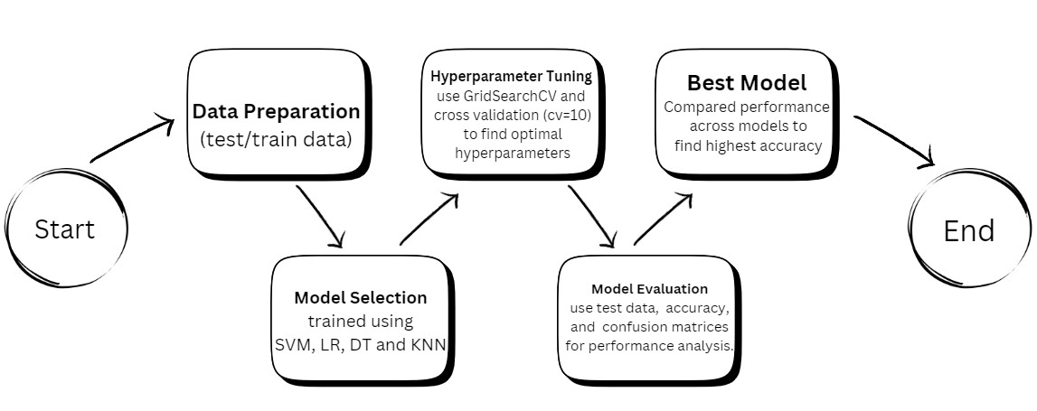
Predictive Analysis (Classification)
Data Preparation: Created a target label column, class, standardized features, and split the dataset into training (80%) and test (20%) sets
Model Selection: Trained four models: SVM, Logistic Regression, Decision Trees, and KNN, using training data
Hyperparameter Tuning: Applied GridSearchCV with cross-validation (cv=10) to find optimal hyperparameters for each model
Model Evaluation: Evaluated models using test data, measured accuracy, and calculated confusion matrices for performance analysis
Best Model: Compared performance across models and selected the one with the highest test accuracy, considering hyperparameters and confusion matrix results
https://github.com/ex22760/Data-Science/blob/main/SpaceX_Machine%20Learning%20Prediction_Part_5.ipynb

Slide 16

Results
Data was cleaned by removing inconsistencies and handling missing values. CCAFS LC-40 had the highest success count, while KSC LC-39A had the highest success ratio (76.9%). The 5000-7000 kg payload range had the highest failure rate, while 2500-7000 kg had the highest success. The 'FT' booster version performed best.
Interactive visualizations mapped launch sites with success/failure markers and distances from coastlines/highways. A dropdown and payload slider enabled dynamic exploration of launch success rates.
Machine learning models were trained and optimized, with SVM achieving the highest accuracy (83.3%), followed by Logistic Regression and KNN. The model helps predict Falcon 9’s landing success, aiding data-driven decision-making.

Slide 17

Section 2

Slide 18
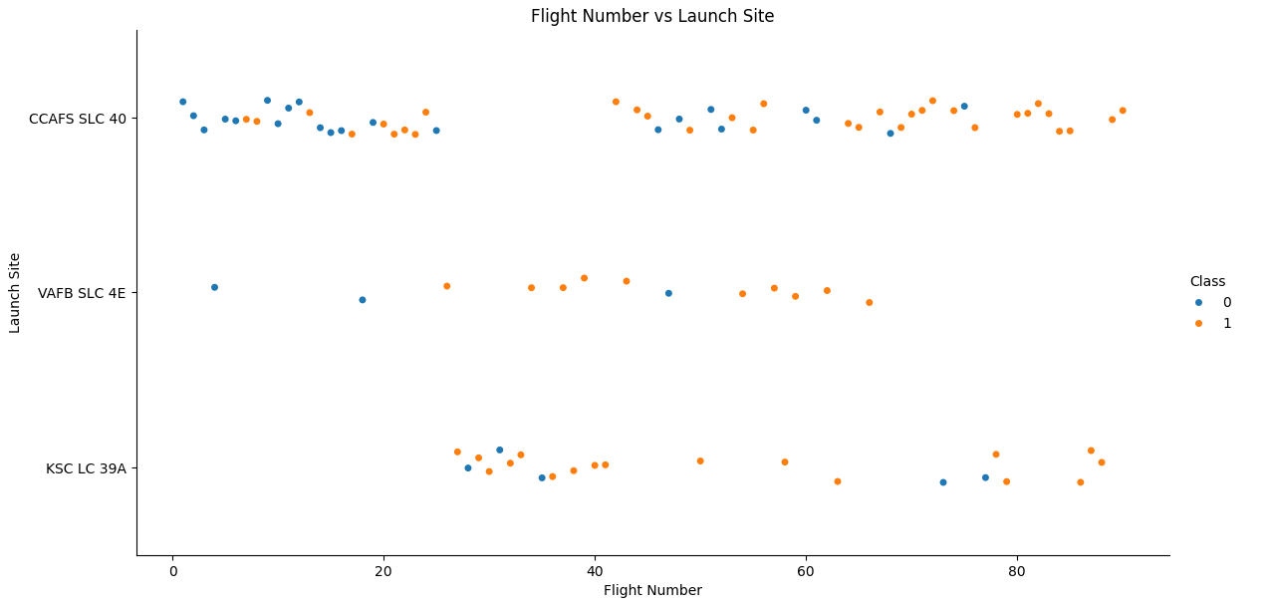
Flight Number vs. Launch Site
The Flight Number vs. Launch Site graph highlights distinct operational patterns for SpaceX’s launch sites over time
KSC LC-39A is inactive between Flight Numbers 0–30 because SpaceX only began using it in 2017 after refurbishing the site
VAFB SLC-4E does not operate between Flight Numbers 70–100, suggesting a reduced focus on polar orbit missions in later flights
CCAFS SLC-40 is inactive between Flight Numbers 30–45, likely due to damage from the 2016 Falcon 9 explosion, with launches temporarily shifting to KSC LC-39A
Notably, CCAFS SLC-40 is the most densely populated launch site, reflecting its historical importance as SpaceX’s primary hub for frequent commercial and government missions
These trends illustrate how infrastructure developments, mission needs, and site availability shaped SpaceX’s launch strategy over time

Slide 19
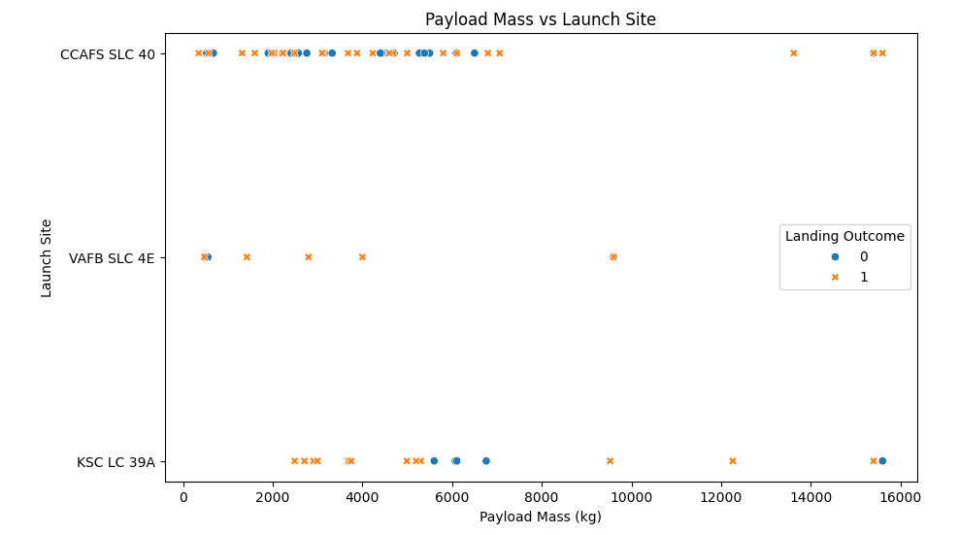
Payload vs. Launch Site
The VAFB-SLC launch site does not handle heavy payloads (above 10,000 kg) due to its primary use for polar and sun-synchronous orbits, which typically carry lighter Earth observation and reconnaissance satellites
Unlike Kennedy Space Centre (KSC) and Cape Canaveral (CCAFS-SLC40), which support high-energy orbital insertions, VAFB-SLC is optimized for medium-lift payloads and lacks the infrastructure for super-heavy rockets like Falcon Heavy
Additionally, safety regulations and launch trajectory constraints further limit the feasibility of heavy payload launches from this site
As a result, SpaceX strategically reserves VAFB for lighter missions while launching heavier payloads from Florida.

Slide 20
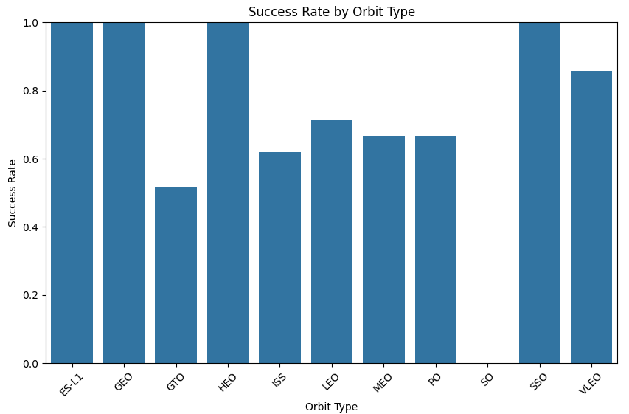
Success Rate vs. Orbit Type
The 100% success rate for SSO, HEO, GEO, and ES-L1 suggests that SpaceX has achieved high reliability in these orbits, likely due to refined launch techniques and proven mission designs
These orbits are commonly used for Earth observation, communications, and deep-space missions, where precision and reliability are critical
In contrast, the 0% success rate for SO (Suborbital) indicates that all such missions failed, likely because they were experimental launches, high-risk technology tests, or early-stage booster recovery trials
Suborbital flights often serve as test missions for new technology, making them more prone to failure compared to established orbital launches
This contrast highlights SpaceX’s success in operational missions while also reflecting the inherent risks of innovation and testing

Slide 21
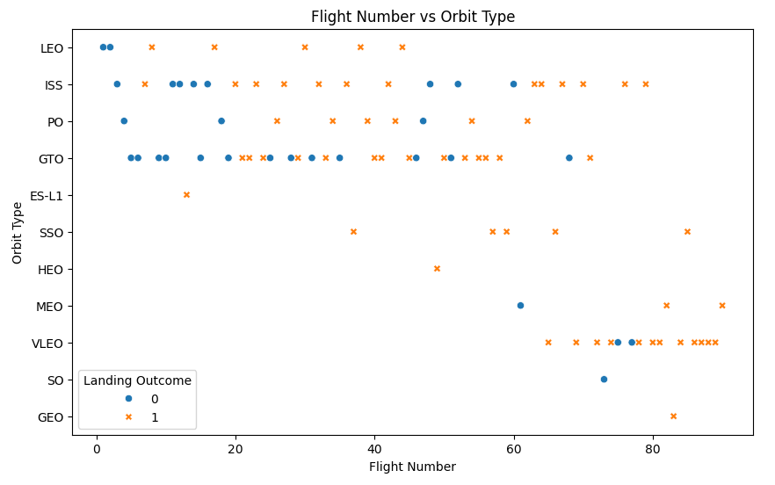
Flight Number vs. Orbit Type
In Low Earth Orbit (LEO), the success rate is closely tied to the number of flights, as repeated missions allow SpaceX to refine launch procedures, enhance reusability, and improve overall reliability
LEO missions, including ISS cargo deliveries, satellite deployments, and booster recovery tests, benefit from iterative improvements, leading to higher success rates over time
In contrast, Geostationary Transfer Orbit (GTO) missions show no clear link between flight number and success, as these launches demand high fuel consumption for payload delivery, often leaving little margin for booster recovery
Factors such as payload weight, trajectory complexity, and fuel limitations play a more significant role in GTO mission outcomes, making experience alone less of a determining factor for success

Slide 22
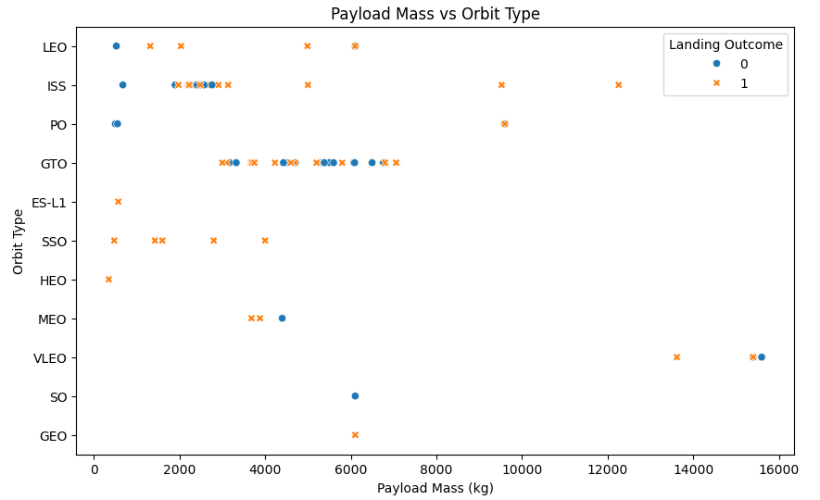
Payload vs. Orbit Type
For heavy payloads, successful landings are more frequent in Polar, LEO, and ISS missions because these orbits generally require less energy, allowing the booster to retain enough fuel for a controlled return and landing
These missions often prioritize reusability, enabling more consistent recovery success
However, for GTO (Geostationary Transfer Orbit) missions, distinguishing between successful and unsuccessful landings is more challenging because both outcomes are common
This is due to higher energy requirements, where the rocket must burn more fuel to reach the required orbit, often leaving insufficient reserves for a controlled landing
As a result, landing success in GTO missions depends on payload weight, trajectory design, and available fuel for the return journey, leading to mixed outcomes.

Slide 23
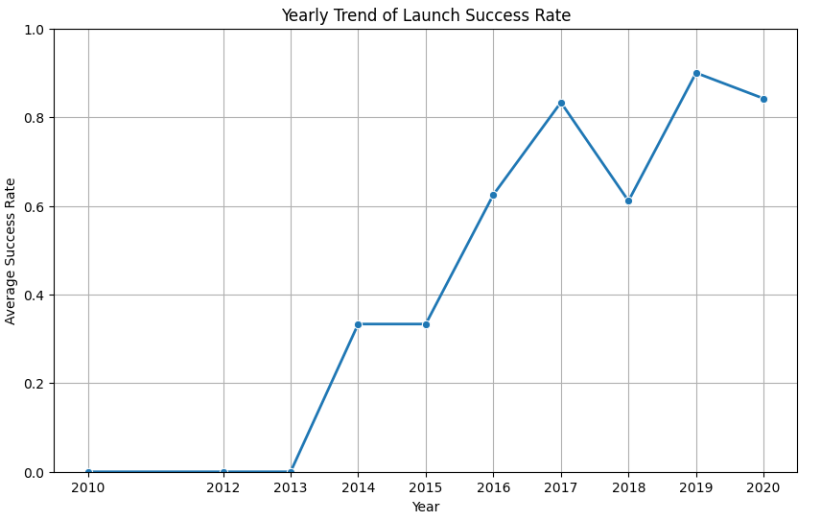
Launch Success Yearly Trend
Since 2013, SpaceX’s launch success rate has steadily increased until 2020, reflecting technological advancements, improved reusability, and refined landing techniques
Early missions had higher failure rates as SpaceX was still developing and testing booster recovery methods, but with each iteration, they enhanced Falcon 9’s reliability, precision landing capabilities, and overall mission success
The introduction of the Falcon 9 Block 5 variant further boosted success rates due to its enhanced reusability and structural upgrades
By 2020, SpaceX had established a highly reliable launch system, successfully executing multiple commercial, scientific, and crewed missions, demonstrating the company’s growing dominance in spaceflight

Slide 24
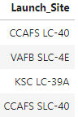

All Launch Site Names
The query result identifies the names of all distinct Launch Sites in the US (see image on RHS)

Slide 25
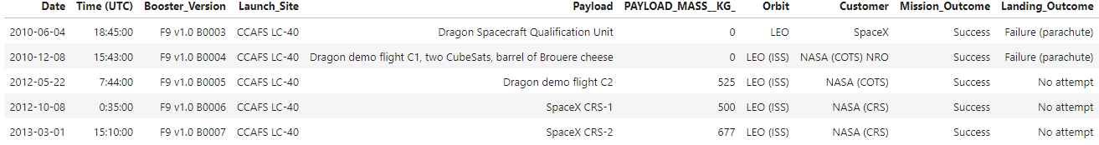
Launch Site Names Begin with 'CCA'
Below are the first 5 records of Launch Sites beginning with ‘CCA’ along with their Date, Time, Booster Version, Payload and its mass, orbit type, the customer and the outcome of the mission and landing

Slide 26

Total Payload Mass
Total payload mass carried by boosters from NASA = 45596kg
This suggests NASA has been responsible for launching significant payload mass using its rockets or collaborative launch systems

Slide 27
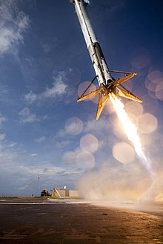
Average Payload Mass by F9 v1.1
Average payload mass carried by booster version F9 v1.1 = 2534.67kg
Serves as a key performance indicator, reflecting the typical payload capacity of this booster version
It allows for comparisons with later versions, such as Falcon 9 Full Thrust and Falcon 9 Block 5, which featured improved efficiency and higher payload capacities
This information is crucial for mission planning, helping organizations determine whether their payloads align with the booster’s capabilities
Additionally, it provides valuable insights into the evolution of SpaceX’s launch vehicles, showcasing advancements in payload capacity and overall rocket performance

Slide 28
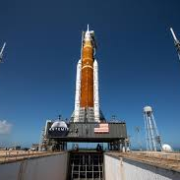
First Successful Ground Landing Date
Date of the first successful landing outcome on ground pad: 22-12-2015
A significant milestone in reusable rocket technology
This achievement demonstrated SpaceX's ability to land and recover boosters on solid ground, improving cost efficiency and sustainability in spaceflight
It also set the stage for further advancements in booster reusability, reducing the need for expendable rockets
This success paved the way for more frequent and reliable land-based recoveries, contributing to the overall evolution of space launch systems

Slide 29
Successful Drone Ship Landing with Payload between 4000 and 6000
Booster_Version
F9 FT B1022
F9 FT B1026
F9 FT B1021.2
F9 FT B1031.2
The payload mass range of 4,000–6,000 kg represents a significant category of mid-range payloads, including medium-sized satellites, cargo missions, and scientific payloads
Drone ship landings are typically used for missions where fuel constraints prevent a return to a ground pad, such as high-energy orbital insertions to geostationary or interplanetary destinations
These successful landings play a crucial role in boosting reusability, as recovered boosters can be refurbished and reused, leading to significant cost reductions in spaceflight
Among the booster versions, the Falcon 9 Block 5 is expected to feature prominently, as it has conducted numerous drone ship landings while offering enhanced reusability and performance improvements over earlier versions

Slide 30
Total Number of Successful and Failure Mission Outcomes
Landing Outcome | Total
Controlled (ocean) | 5
Failure | 3
Failure (drone ship) | 5
Failure (parachute) | 2
No attempt | 21
No attempt | 1
Precluded (drone ship) | 1
Success | 38
Success (drone ship) | 14
Success (ground pad) | 9
Uncontrolled (ocean) | 2
The total number of successful and failed mission outcomes provides a crucial measure of a space program’s reliability and progress
A high success rate indicates advancements in technology, improved launch procedures, and refined recovery techniques, contributing to greater confidence among stakeholders, including space agencies, commercial clients, and investors
On the other hand, failure data is equally significant, as it highlights challenges, informs future improvements, and drives innovation in rocket design, navigation, and safety systems
By analysing both successes and failures, organisations can enhance mission planning, optimize risk management, and work toward achieving a higher level of mission reliability and cost efficiency in space exploration

Slide 31
Booster_Version
F9 B5 B1048.4
F9 B5 B1049.4
F9 B5 B1051.3
F9 B5 B1056.4
F9 B5 B1048.5
F9 B5 B1051.4
F9 B5 B1049.5
F9 B5 B1060.2
F9 B5 B1058.3
F9 B5 B1051.6
F9 B5 B1060.3
F9 B5 B1049.7
Boosters Carried Maximum Payload
Identifying the boosters that have carried the maximum payload mass is significant for understanding the performance and capability of different launch vehicles
Boosters that have lifted the heaviest payloads demonstrate higher thrust, improved fuel efficiency, and advanced engineering, making them ideal for deep-space missions, large satellite deployments, and crewed spaceflight
These high-capacity boosters, such as Falcon Heavy or upgraded Falcon 9 variants, showcase the evolution of rocket technology and SpaceX’s ability to transport heavier payloads to orbit
This data is also valuable for future mission planning, ensuring that payloads are matched with the most suitable boosters for efficient and cost-effective launches

Slide 32
2015 Launch Records
Analysing failed landing outcomes on a drone ship in 2015, along with their booster versions and launch site names, provides insights into the early challenges of rocket reusability
During this period, SpaceX was actively testing and refining its booster recovery technology, which was critical for reducing launch costs
Failures in landing attempts often resulted from engine issues, unstable landings, or harsh sea conditions, leading to hard landings or destruction of the booster
Understanding these failures helps SpaceX improve landing algorithms, navigation precision, and structural enhancements in future booster designs
Additionally, studying launch sites provides context on how different locations and mission profiles impact recovery success
These lessons have played a vital role in SpaceX’s journey toward consistent and reliable booster landings on drone ships.
Month | Landing_Outcome | Booster_Version | Launch_Site
January | Failure (drone ship) | F9 v1.1 B1012 | CCAFS LC-40
April | Failure (drone ship) | F9 v1.1 B1015 | CCAFS LC-40

Slide 33
Rank Landing Outcomes Between 2010-06-04 and 2017-03-20
Landing_Outcome | landing_count
No attempt | 10
Success (drone ship) | 5
Failure (drone ship) | 5
Success (ground pad) | 3
Controlled (ocean) | 3
Uncontrolled (ocean) | 2
Failure (parachute) | 2
Precluded (drone ship) | 1
Ranking the count of landing outcomes between June 4, 2010, and March 20, 2017, provides a clear picture of SpaceX's progress in booster recovery efforts
During this period, SpaceX transitioned from expendable rockets to reusable boosters, experimenting with different landing techniques on both drone ships and ground pads
The rankings highlight the most frequent outcomes, showing how often SpaceX succeeded, failed, or attempted alternative recovery methods like controlled ocean landings
A higher count of successful landings reflects improvements in technology, while failure counts reveal challenges that led to further refinements in guidance systems, landing legs, and thruster control
This data is crucial for analyzing the evolution of reusability, measuring progress, and identifying key milestones in SpaceX’s pursuit of fully reusable launch systems.

Slide 34

Section 3

Slide 35
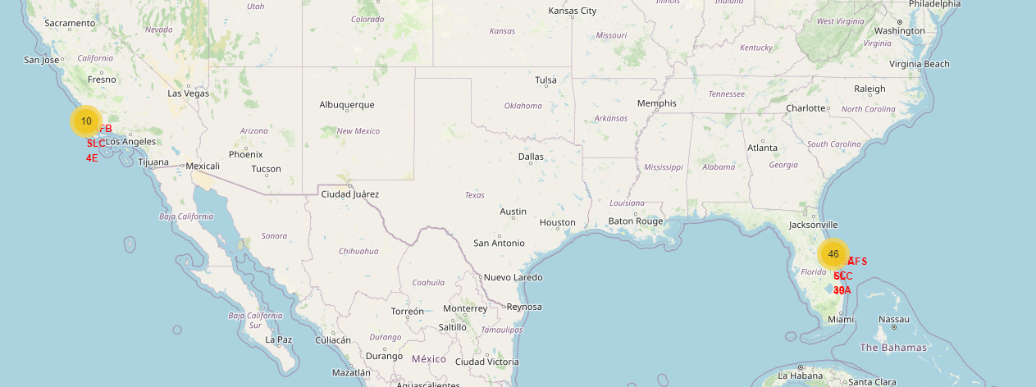
Launch Sites on a Global Map
The map clearly illustrates the strategic placement of launch sites along the southwest and southeast coast of America, particularly in Florida and California. This coastal positioning is likely chosen for easier access to open ocean for rocket launches, ensuring safety and minimizing risk to populated areas
The coastal proximity of these launch sites provides a significant advantage for launching rockets over the ocean, reducing the risk to populated areas in the event of a failure or rocket re-entry.
There seems to be a higher concentration of launch sites on the southeastern coast, specifically in Florida, near Kennedy Space Centre (KSC) and Cape Canaveral Space Force Station (CCAFS), which indicates its historical significance as a primary launch hub for space exploration.

Slide 36
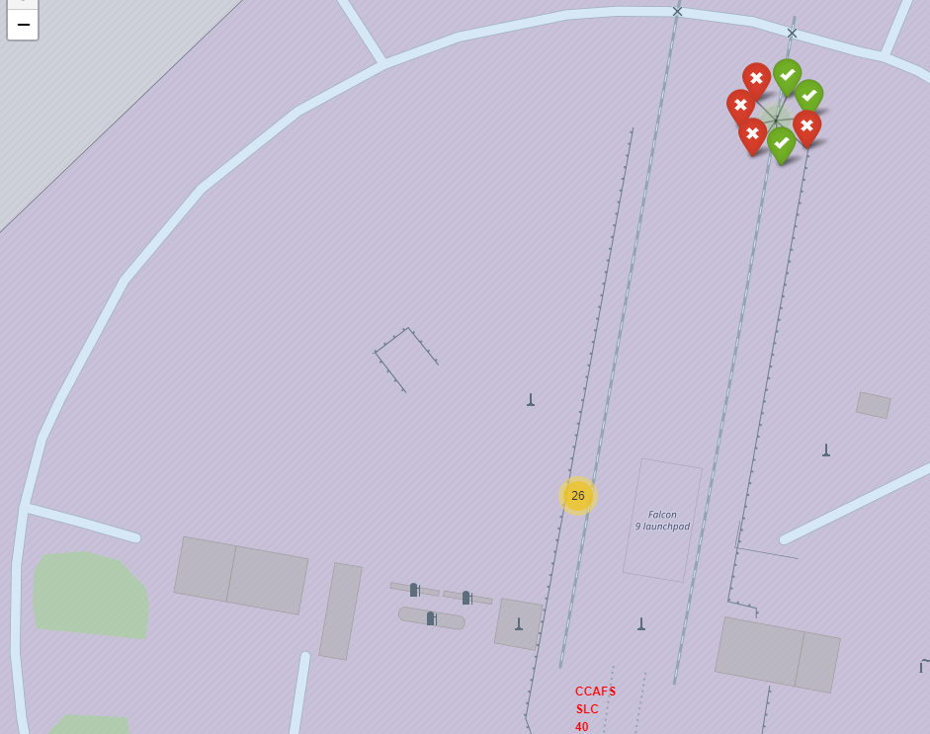
Colour labelled outcomes on map
The coloured labels on the launch sites (green for success and red for failure) provide a quick visual representation of the performance history of each site. This makes it easier to assess the launch success rate immediately
The fact that a site has 3 green (successful) and 4 red (failed) labels suggests that, although it has had some success, the site is still experiencing a notable number of failures. This could indicate the need for further investigation into operational issues, rocket technology, or external factors that might contribute to failures at this location

Slide 37
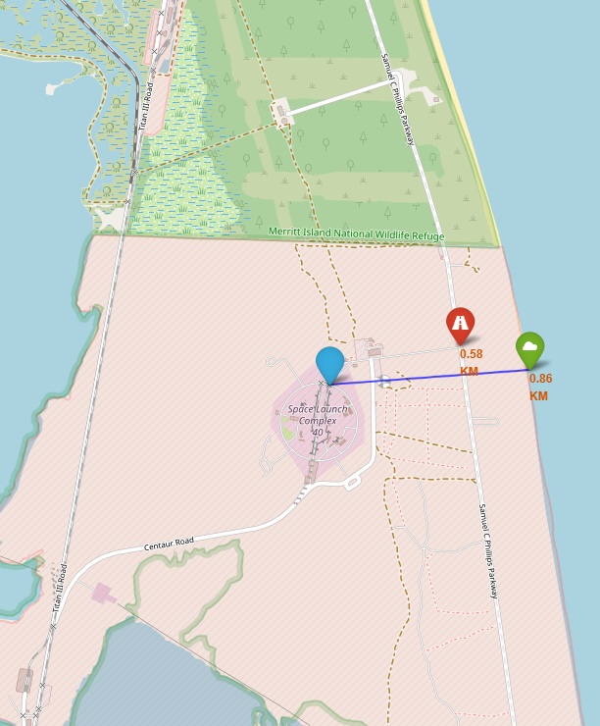
Proximities to launch sites
The launch site is located 0.58 km from a highway. Being close to a highway could provide efficient access for transportation of materials and equipment, which is beneficial for logistics and operational efficiency
The proximity to the coastline (0.86 km) might play a role in safety and environmental considerations during launches. Coastal locations often offer a safer space for rocket launches, as they provide a clear trajectory over water, reducing the risks to populated areas. The relatively short distance from the coast may also suggest ease of accessibility to maritime resources in case of emergencies or recovery operations

Slide 38

Section 4

Slide 39
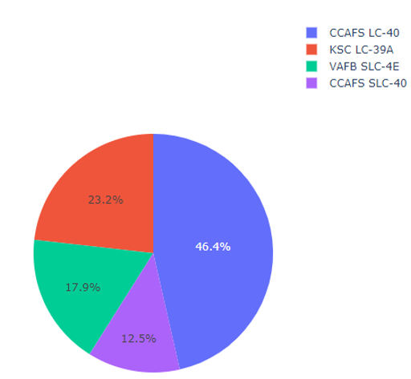
Launch Success Count for all Sites
The highest success count out of all launch sites is that of CCAFS LC-40’s with a rate of 46.4%

Slide 40
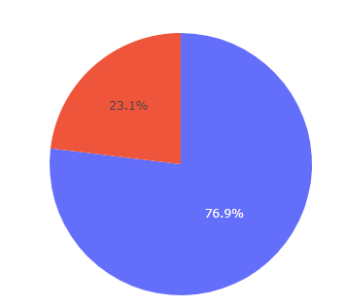
Highest Launch Success Ratio
KSC LC-39A has the highest launch success ratio at 76.9%

Slide 41
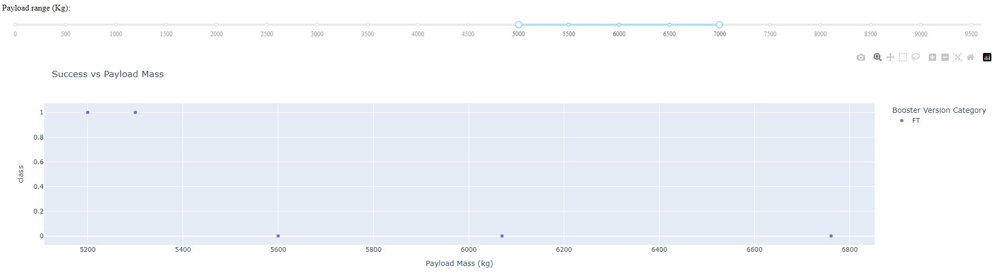
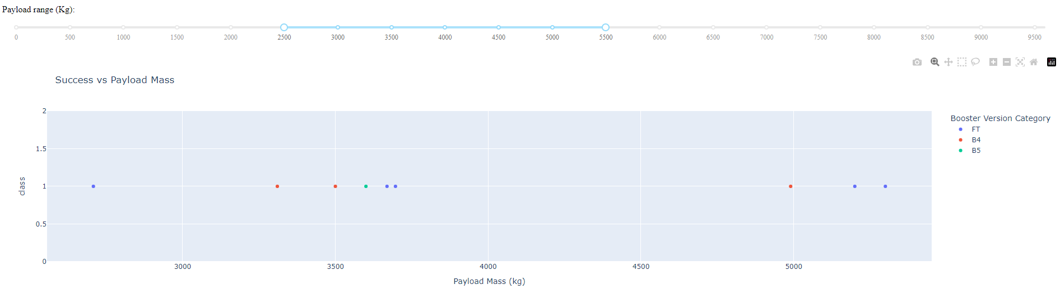
Payload vs Launch Outcome
The 5000-7000 Payload rage(kg) has the highest failure rate with the booster version ‘FT’.
The 2500 – 7000 Payload Range (kg) has the highest success rate with no failures
The booster version that has the largest success is ‘FT’

Slide 42

Section 5

Slide 43
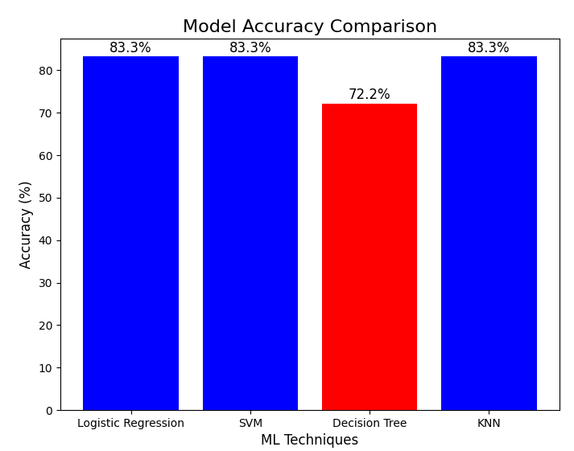
Classification Accuracy
All Machine Learning models except Decision Trees averaged an 83.3% accuracy performing equally best

Slide 44
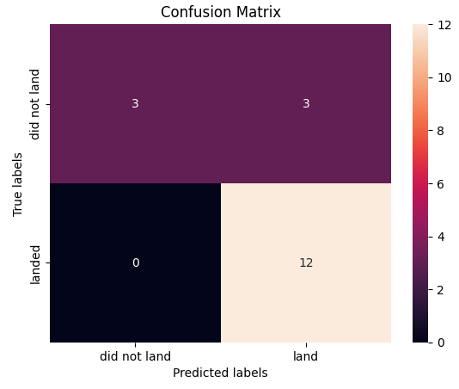
Confusion Matrix
This is the confusion matrix of the SVM model which is generally the most powerful ML models
This has a True Positive Rate of 100%

Slide 45
Launch Sites: The highest launch success count was seen at CCAFS LC-40 (46.4% success rate), while KSC LC-39A had the highest launch success ratio (76.9%)
The 5000-7000 kg payload range exhibited the highest failure rate, particularly with the FT booster version.
The 2500-7000 kg payload range demonstrated the highest success rate, with no recorded failures in that range
Booster Version: The FT booster version had the highest success rate across the dataset.
Model Performance: The SVM (Support Vector Machine) classifier performed the best with an accuracy of 83.3% among the machine learning models.
Conclusions

Slide 46
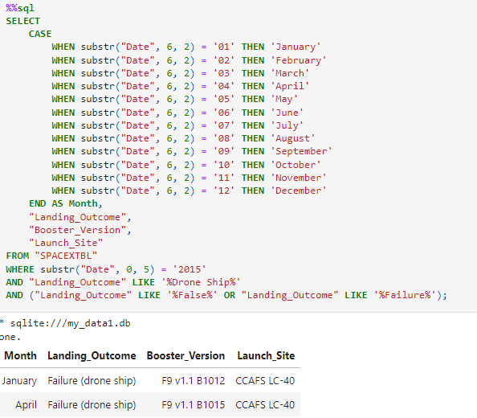
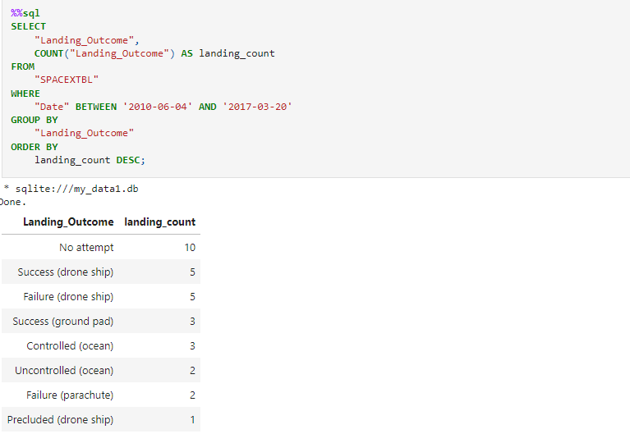
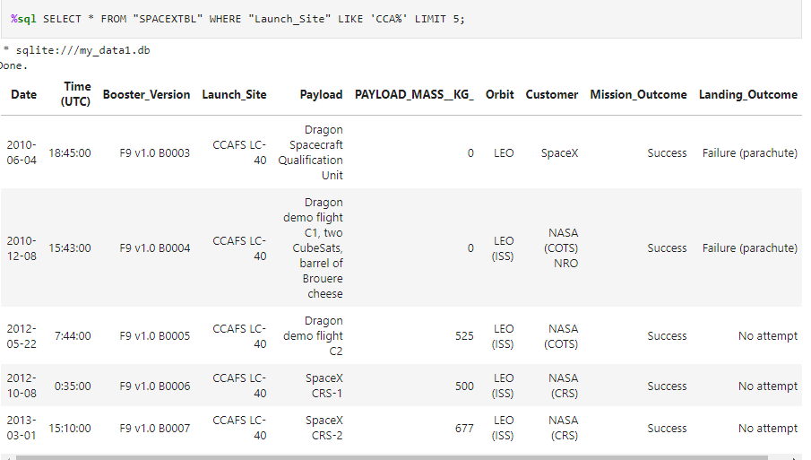
Appendix
List of useful but unmentioned SQL query results with insights about specific launch sites

Slide 47


